Slide 1
Reaching Decision Makers: Using Science to Inform Policy:
Jamey Fidel
General Counsel, Forest and Wildlife Program Director
Vermont Natural Resources Council

Slide 2
Using Science to Inform Policy
Science - provides foundation for policy issue. Necessary research is conducted. Science and data are presented and/or published.
Awareness building – led by agency, non-government organization, academia, institution, etc.
Defining catalyst – event, stakeholder process, tipping point.
Science is integrated into final policy - provides the basis for action.
Advocacy – Comes in different forms.

Slide 3
Example #1-Flood/Erosion Regulations
Science provides foundation for policy issue. Science and data are presented and/or published. Rivers Program at ANR develops the science of fluvial geomorphology.
Awareness building – Rivers Program demonstrates to state, regional and local planners and policy makers that we need to recognize that river corridors will move, and we have to make decisions about where we develop and build infrastructure based on these realities.
Advocacy – The science of fluvial geomorphology is incorporated into the local and regional planning process with a number of towns adopting flood and erosion hazard regulations that account for the movement of rivers.
Defining catalyst – Hurricane Irene. Demonstrated impacts of development and infrastructure in erosion hazard areas where rivers move under extreme flood events.
Science is integrated into final policy - New state regulations on river corridors and erosion hazard areas.
Notes:
Rules guide 248 process and municipal guidance for bylaws. Statutory goals for municipal and regional planning. This above and beyond FEMA requirements.

Slide 4
Example #2-Forest Fragmentation Policy
Science provides foundation for policy issue. Science and data are presented and/or published. Forest fragmentation research is published identifying ecological impacts. Mapping of intact forest blocks in conducted. Land use trend analysis in forest areas published.

Slide 5
Example #2-Forest Fragmentation Policy
Awareness building – Forest Roundtable on Parcelization and Forest Fragmentation convenes for a decade to examine science and build awareness in Vermont.
Notes:
Coalition is formed. Communication is enhanced through a report.

Slide 6
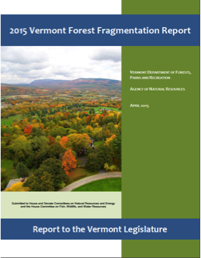
Example #2-Forest Fragmentation Policy
Catalyst – Legislature requests reports on forest fragmentation with policy recommendations.
Notes:
Communication is enhanced through formal process bringing credibility to issue.

Slide 7
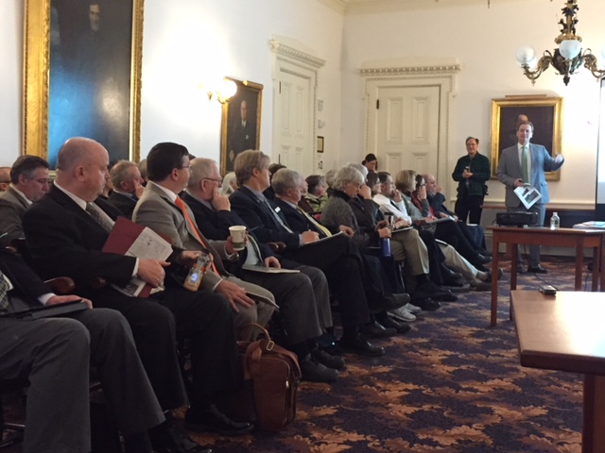
Example #2-Forest Fragmentation Policy
Advocacy – Presentations to the Legislature, testimony from scientists, lobbying, coalition building, grassroots support, etc..

Slide 8
Example #2-Forest Fragmentation Policy
Science is integrated into new policy – New legislation to address forest fragmentation through municipal, regional planning and statewide land use development review.
Act 171 - 2016
Act 233 - 2017

Slide 9
Reflections on Science > Policy
Science provides a foundation for policy.
Scientists can partake in awareness building, technical expertise, and communication that relates to advocacy.
Testimony from scientists can help to build credibility of policy action.
In the case of legislative policy, science and advocacy are both essential, along with grassroots support.
Science can both speed up and slow down policy making.
Identifying catalysts for action – Irene, legislative or agency interest, health threat (PFOA contamination), etc.
Find or create venues to share information and develop effective communication to shape policy.

